Slide 1

ARDUINO – Day4
BIOE 3090

Slide 2

Activity 7 – Blink_3090 – Debounce
Using
pbLastDebounceTime
pbDebounceDelay
digitalRead()
Millis()
Create
pb_debounce function
Now with Pushbutton Action!!!!

Slide 3
Program Flowchart Debounce
Loop
check_pushbutton()
Begin
N
If
Y
Pb_debounce()
Pin Definitions
Pushbutton pressed
PB_PIN
If
pbLatch = true
Setup
Pushbutton is
Still pressed PB_PIN
Blink_timer()
N
If
Y
blink_led()
Elapsed Time > Switch Time
&& pbLatch == true

Slide 4
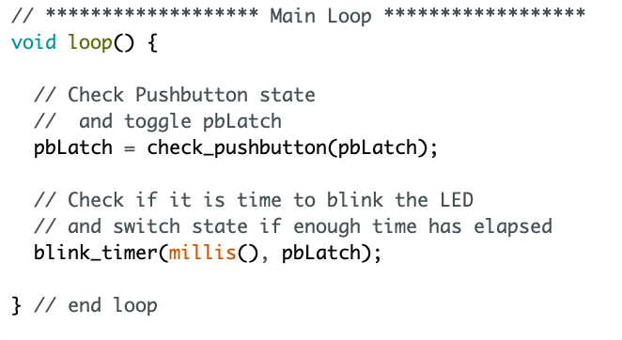
Polling with Debounce
Changed Function Here
Passing pbLatch

Slide 5
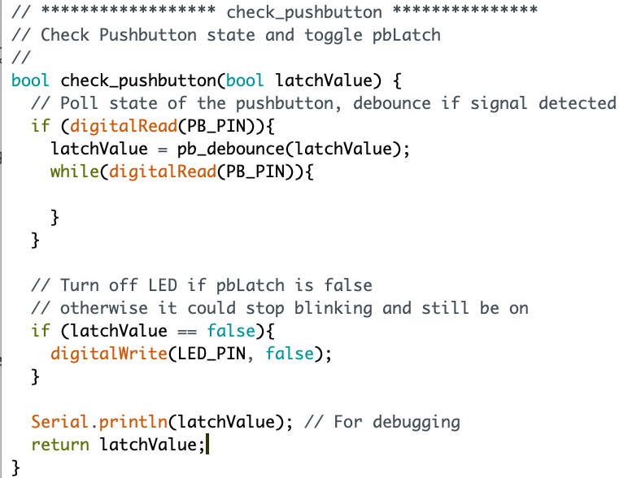
Check Pushbutton
pb_debounce fcn called
here

Slide 6
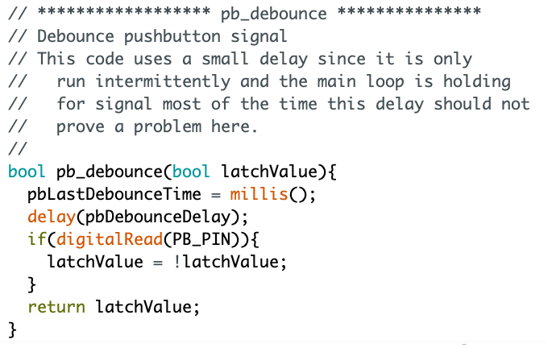
Debounce Code
Return variable type
Very small delay
If button still pressed after delay, latch PB
Return variable

Slide 7
ARDUINO – Day4 – Part 2
BIOE 3090

Slide 8
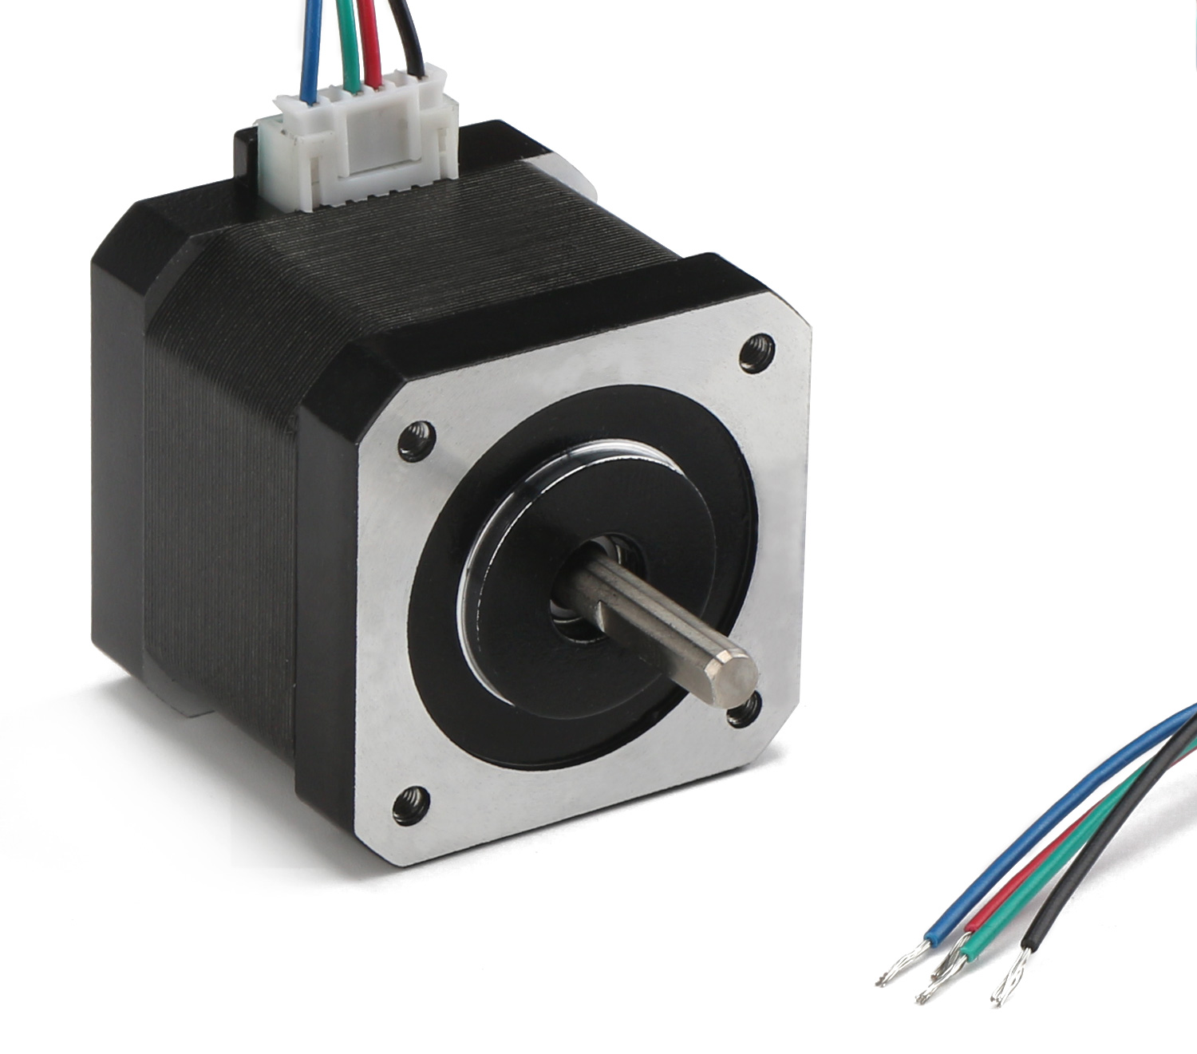
Stepper Motors
Brushless DC motor
200 positions / rotation
1.8 degrees
High torque
Low speed
Accurate rotational positioning
Needs to be indexed

Slide 9
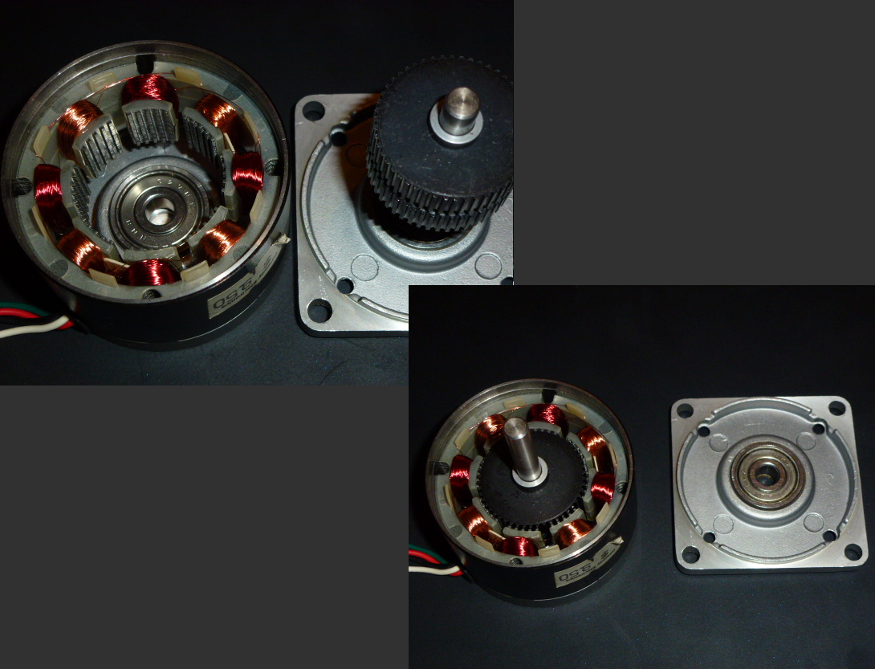
Stepper Motors
4-Wire
Basic Bi-polar stepper
6-Wire
Unipolar Stepper
High Torque
Low Speeds

Slide 10
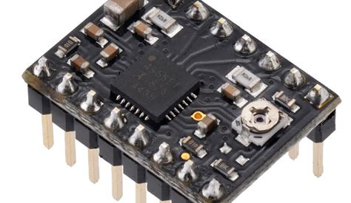
Stepper Motor Drivers
Forward / Reverse
Dir Pin
1-step / low – high signal
Step Pin
Microstepping
MS1
MS2
MS3
12 V Motor Supply
VOMT
Enabled Low
Enable (bar)

Slide 11
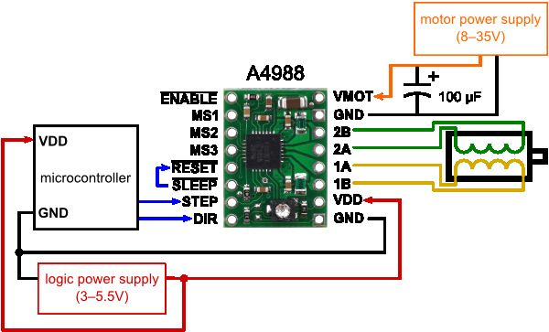
Stepper Motor Driver Wiring
Keep 12V separate from 5V & Arduino pins!
GND
Jumpered
Polarity Matters
Arduino
Header
Wiring different here.

Slide 12
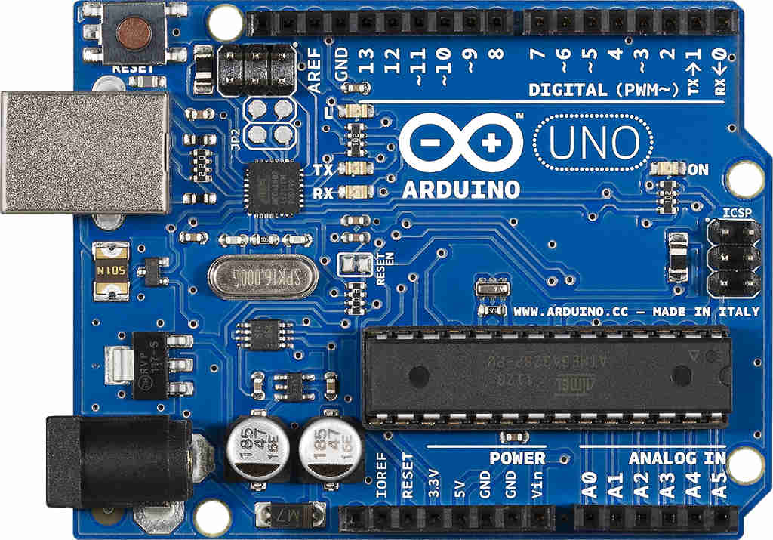
5V Power Wiring
USB to Computer
To Breadboard and Stepper Driver
GND
5V

Slide 13
Activity 8 – Stepper Motor - Wiring
Using
Provided parts
Stepper Motor Driver Wiring Diagram
Create
Stepper motor and driver on breadboard with Arduino LED
Motor Action!!!!

Slide 14
Program Flowchart Debounce
Loop
check_pushbutton()
Begin
N
If
Y
Pb_debounce()
Pin Definitions
Pushbutton pressed
PB_PIN
If
pbLatch = true
Setup
Pushbutton is
Still pressed PB_PIN
Blink_timer()
N
If
Y
blink_led()
Elapsed Time > Switch Time
&& pbLatch == true
run_stepper()

Slide 15
Program Flowchart Run Stepper
Loop
pbLatch = false
Begin
N
If
Y
Pb_debounce()
Pin Definitions
Pushbutton pressed
If
pbLatch = true
Setup
Pushbutton is
Still pressed
Blink_timer()
N
If
Y
blink_led()
Elapsed Time > Switch Time
&& pbLatch == true
run_stepper()

Slide 16
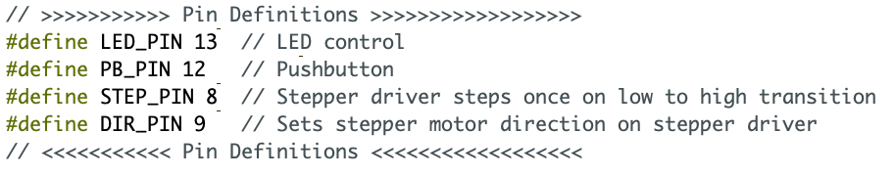
Stepper Pins

Slide 17
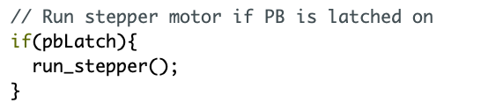
In Main Loop

Slide 18
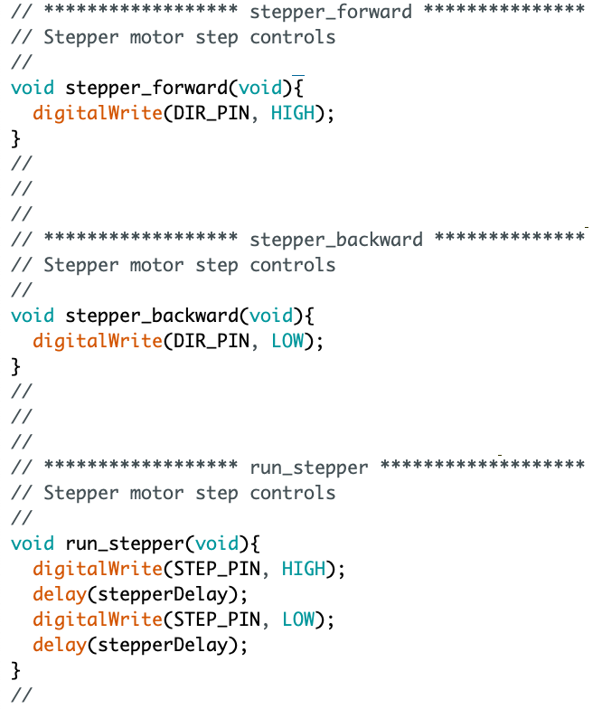
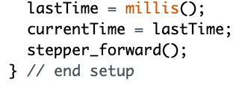
Functions - Stepping
In Setup

Slide 19
Activity 9 – Stepper Motor Programming
Using
STEP_PIN
DIR_PIN
Create
Stepper_forward()
Stepper_backward()
Run_stepper()
Motor Action!!!!

Slide 20
ISR timer is a better way
Interrupt
Service
Routine
Hijack Timer1 on Microcontroller
We are not going to do this…

